Slide 1
LOST SPRING
By Anees Jung

Slide 2
About the Author
Anees Jung is an Indian female author, journalist and columnist who writes for major newspapers in India and abroad. She was born in Rourkela and belongs to an aristocratic family in Hyderabad. Her father, Nawab Hoshyar Jung, who was a renowned scholar and poet, worked as the musahib (adviser) to the last Nizam (prince) of Hyderabad State. And her mother and brother are also well-known Urdu poets.
Jung hit the headlines with the publication of ‘Unveiling India in 1987’, which is primarily a travel diary that focuses on interviews with women. She went on write many subsequent books on the same topic, and talked to women about their everyday lives, and wrote books like ‘Night of the New Moon: Encounters with Muslim women in India’ (1993) and Seven Sisters (1994). Her book ‘Breaking the Silence (1997) includes conversations on women’s lives from around the world.

Slide 3
Introduction
The story, “Lost Spring” describes the pitiable condition of poor children who have been forced to miss the joy of childhood due to the socio-economic condition that prevails in this man-made world. These children are denied the opportunity of schooling and forced into labour early in life. Anees Jung gives voice to eliminate child labour by educating the children and to enforce the laws against child labour strictly. The call is to end child exploitation and let the children enjoy the days.
Characters: Saheb-e-Alam: A rag picker
Mukesh: Son of a bangle maker

Slide 4
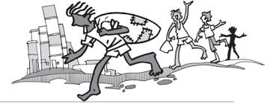
Vocabulary
Scrounging – searching for
Glibly - speaking or spoken in a confident way, but without careful thought or honesty
Hollow – meaningless
Embarrassed - feeling ashamed
abound - exist in large numbers
bleak – empty
perpetual state of poverty - never ending condition of being poor
Desolation - the state of being empty
Panting - taking short and quick breathes

Slide 5
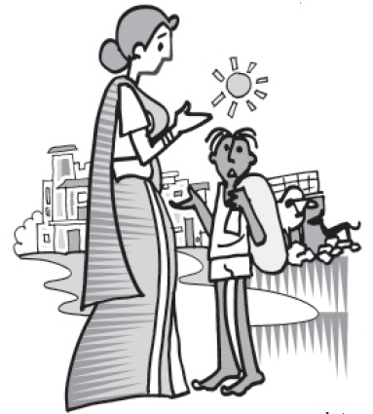
Desolation - the state of being empty
Panting - taking short and quick breathes
Acquaintance - contact
periphery- outer area
metaphorically–symbolically
squatters - a person who unlawfully occupies
an uninhabited building or unused land
wilderness- a wasteland
tarpaulin- heavy-duty waterproof cloth
Transit homes – a temporary home
looms like a mirage - seems that it will be true in the future but actually it will not be so

Slide 6
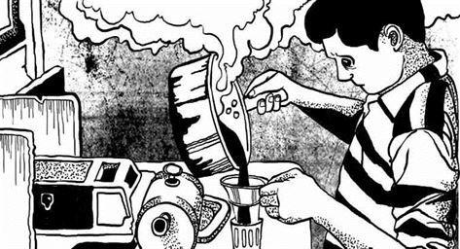
Hovels – slums
Crumbling – falling down
Wobbly – unsteady
Coexisting - present at the same time and place
Primeval – prehistoric
Bangs – hits
Shack – a roughly built hut
Thatched – covered with dry grass
Vessel – container for cooking food
Sizzling - make a hissing sound when frying or cooking
Platters – large plates
Chopped – cut finely
Frail – thin, weak
Impoverished – very poor
God-given lineage - here, a profession carried on through the generations of a family – glass bangle making

Slide 7
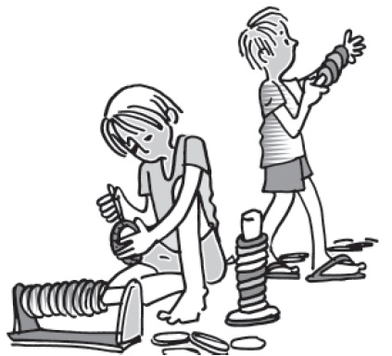
Unkempt – not taken care of
Shanty town - a town that is full of small, roughly built huts
Drab – faded, colourless
Sanctity - the state of being sacred or holy
Draped – covered
Vicious – cruel
Hauled up – dragged, taken away
Apathy – lack of concern
Stigma – dishonor
Hurtling down – moving around

Slide 8
Summary (Part I): ‘Sometimes I Find a Rupee in the Garbage’ - Saheb-e-Alam (A rag picker)
The first part tells the writer’s impressions about the life of the poor rag pickers. The rag pickers have migrated from Dhaka and found a settlement in Seemapuri (India). Their fields and homes had been swept away by storms (Socio Political Unrest). They had come to the big city to find a living. They are poor. The writer watches Saheb every morning scrounging for “gold” in her neighbourhood. Garbage is a means of survival for the elders and for the children it is something wrapped in wonder. The children come across a coin or two from it. These people have desires and ambitions, but they do not know the way to achieve them. There are quite a few things that are unreachable to them, namely shoes, tennis and the like. Later Saheb joins a tea stall where he could earn 800 Rupees and all the meals. The job has taken away his freedom.

Slide 9
Part II – I Want to Drive a Car – Mukesh: Son of a bangle maker
The second part deals with the life of Mukesh, who belongs to the family of Bangle-makers. Firozabad is best known for its glass-blowing industry. Nearly 20,000 children are engaged in this business and the law that forbids child labour is not known here. The living condition and the working environment is a woeful tale. Life in dingy cells and working close to hot furnaces make these children blind when they step into the adulthood. Weighed down by the debt, they can neither think nor find a way to come out of this trap. The politicians, middlemen, policemen and bureaucrats obstruct their ways of progress. The women in the household consider it as their fate and just follow the tradition. Mukesh is different from the rest of the folk there. He dreams to become a motor mechanic.

Slide 10
Gist: (Sometimes I find a rupee in garbage)
The author examines and analyses the impoverished conditions and traditions that condemn children to a life of exploitation these children are denied an education and forced into hardships early in their lives.
The writer encounters Saheb – a rag picker whose parents have left behind the life of poverty in Dhaka to earn a living in Delhi.
His family like many other families of rag pickers lives in Seemapuri. They do not have other identification other than a ration card.
The children do not go to school and they are excited at the prospect of finding a coin or even a ten rupee note for rummaging in the garbage.

Slide 11
It is the only way of earning.
The writer is pained to see Saheb, a rag picker whose name means the ruler of earth, Lose the spark of childhood and roams barefooted with his friends.
From morning to noon the author encounters him in a tea stall and is paid Rs. 800 He sadly realizes that he is no longer his own master and this loss of identity weighs heavily on his tender shoulders.

Slide 12
I want to drive a car
The author then tells about another victim, Mukesh who wants to be a motor mechanic.
He has always worked in the glass making industry.
They are exposed to various health hazards like losing their eyesight as they work in abysmal conditions, in dark and dingy cells.
Mukesh’s father is blind as were his father and grandfather before him.
So burdened are the bangle makers of Firozabad that they have lost their ability to dream unlike Mukesh who dreams of driving a car.

Slide 13
Useful Links:
https://www.youtube.com/watch?v=lNwsoEPyjcM
https://www.learncbse.in/ncert-solutions-for-class-12-flamingo-english-lost-spring/
https://edunation19.blogspot.com/2019/10/lost-spring-summary-class-12-ncert.html

